Slide 1
CS 35L Software Construction Lab Week 4 - Python

Slide 2

What is Python?
Object-Oriented language
Classes
Member functions
Interpreted language
Python code is compiled to bytecode
Bytecode interpreted by an interpreter
Interactive
Why?

Slide 3
Python List
Common data structure in Python
A python list is like a C array but much more:
Dynamic (mutable): expands as new items are added
Heterogeneous: can hold objects of different types
How to access elements?
List_name[index]

Slide 4
Example
>>> t = [123, 3.0, ‘hello!’]
>>> print t[0]
123
>>> print t[1]
3.0
>>> print t[2]
hello!

Slide 5
Example – Merging Lists
>>> list1 = [1, 2, 3, 4]
>>> list2 = [5, 6, 7, 8]
>>> merged_list = list1 + list2
>>> print merged_list
Output: [1, 2, 3, 4, 5, 6, 7, 8]

Slide 6
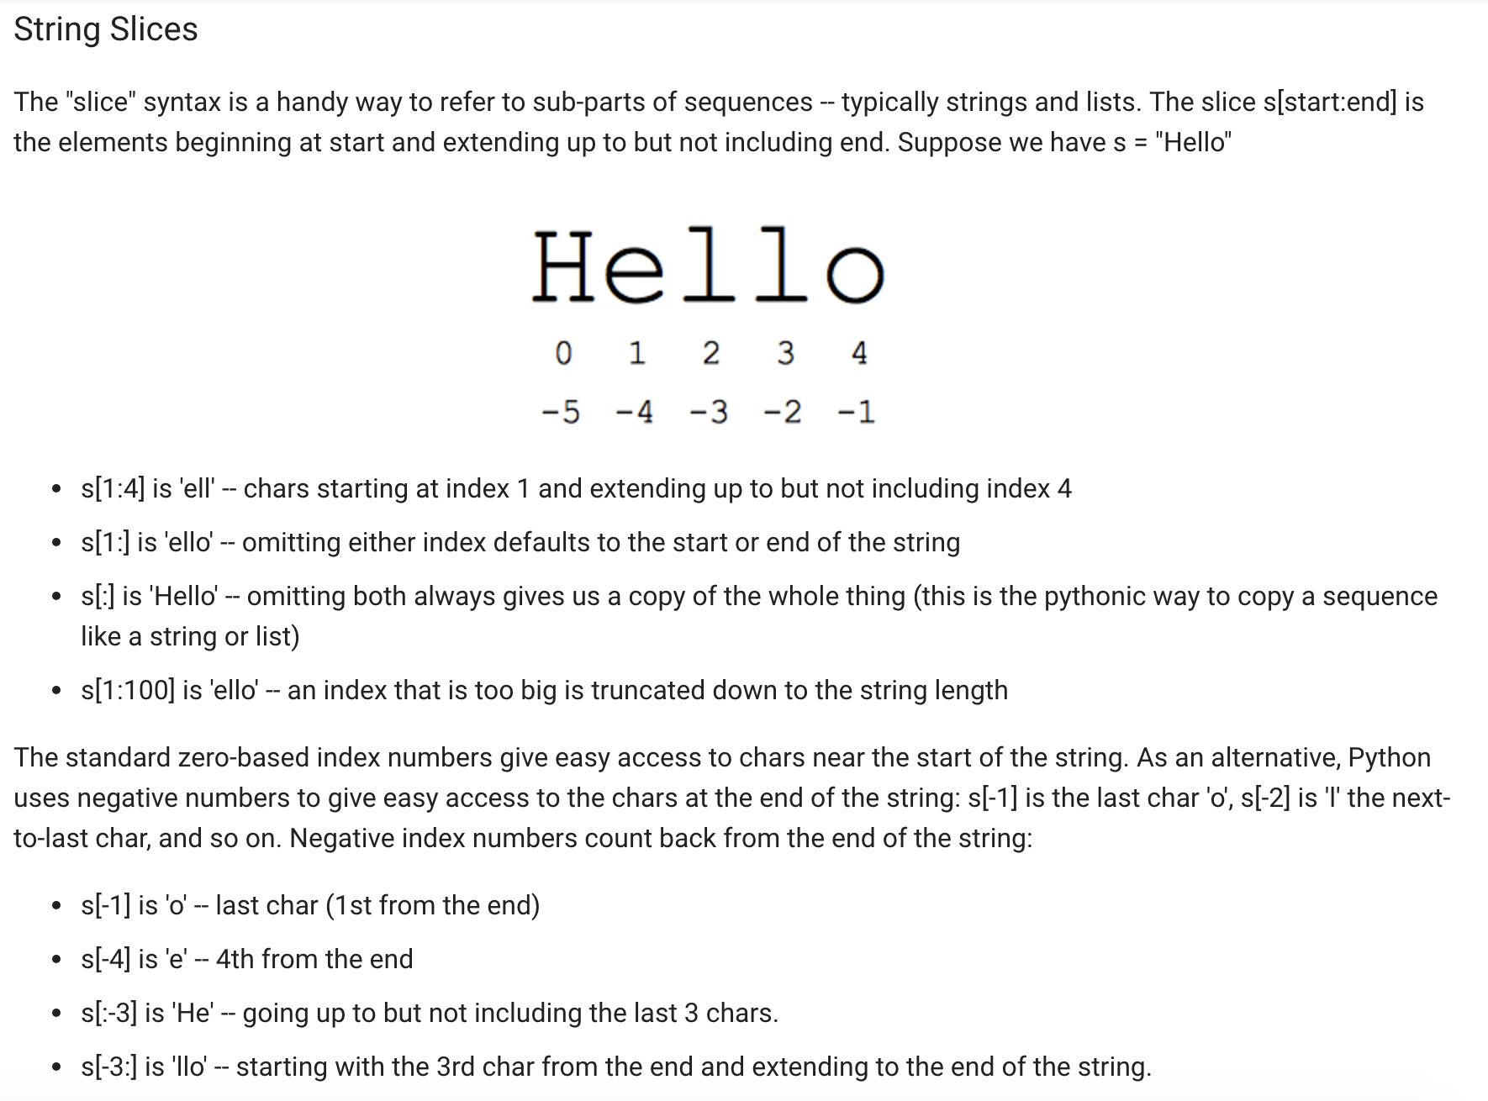

Slide 7
Python Dictionary
Essentially a hash table
Provides key-value (pair) storage capability
Instantiation:
dict = {}
This creates an EMPTY dictionary
Keys are unique, values are not!
Keys must be immutable (strings, numbers, tuples)

Slide 8
Example
dict = {}
dict[‘hello’] = “world”
print dict[‘hello’]
world
dict[‘power’] = 9001
if (dict[‘power’] > 9000):
print “It is over “, dict[‘power’]
It is over 9001
del dict[‘hello’]
del dict

Slide 9
for loops
list = [‘Mary’, ‘had’, ‘a’, ‘little’, ‘lamb’]
for i in list:
print i
Result:
Mary
had
a
little
lamb
for i in range(len(list)):
print i
Result:
0
1
2
3
4

Slide 10

Indentation
Python has no braces or keywords for code blocks
C delimiter: {}
bash delimiter:
then…else…fi (if statements)
do…done (while, for loops)
Indentation makes all the difference
WHITESPACES are important!!!
Tabs change code’s meaning!!

Slide 11
Optparse Library
Powerful library for parsing command-line options
Argument:
String entered on the command line and passed in to the script
Elements of sys.argv[1:] (sys.argv[0] is the name of the program being executed)
Option: (like linux flags)
An argument that supplies extra information to customize the execution of a program
Option Argument:
An argument that follows an option and is closely associated with it. It is consumed from the argument list when the option is

Slide 12
I/O Basics
The raw_input([prompt]) function reads one line from standard input and returns it as a string (removing the trailing newline)
str = raw_input("Enter your input: ");
print "Received input is : ", str
The input([prompt]) function is equivalent to raw_input, except that it assumes the input is a valid Python expression and returns the evaluated result to you.
str = input("Enter your input: ");
Print "Received input is : ", str

Slide 13
Python programming

Slide 14
Python Variables
Case sensitive
Start with _ (underscore) or letters followed by other letters, underscores or digits
Other special characters are not allowed as part of the variable name
Certain reserved words may not be used as variable names on their own unless concatenated with other words

Slide 15
Example: Python Variables
Python Script:
#!/usr/bin/python
counter = 100 # An integer assignment
miles = 1000.0 # A floating point
name = "John" # A string
print counter
print miles
print name
Output:
100
1000.0
John

Slide 16
Functions
A function is a block of organized, reusable code that is used to perform a single, related action. They provide better modularity for your application and a high degree of code reusing.
Syntax:
def function_name( parameters ):
#code inside the function

Slide 17
Functions examples
Example 1:
def printme(new_string): #string is a parameter
#This prints a passed string into this function
print new_string
return
Example 2: To print sum of numbers in a list
def find_sum(new_list):
sum=0 #initialize variable*
for element in new_list:
sum = sum + element
return sum #returns the computed sum
answer_variable=find_sum([2,3,4,5]) #function call
print answer_variable
* # are used for putting comments

Slide 18
Python split
Python split using delimiter:
>>> x = “blue, red, green”
>>> x.split(“,”) #”,” is a delimiter here
Output: [‘blue’, ‘red’, ‘green’]
>>> a, b, c = x.split(“,”)
>>> a
‘blue’
>>> b
‘red’
>>> c
‘green’

Slide 19
Task 1
Take a list a = [1, 1, 3, 8, 13, 21, 34, 55, 89] and write a program that prints out all the elements of the list that are less than 5
Instead of printing the elements one by one, make a new list that has all the elements less than 5 from this list in it and print out this new list.
new_list.append(element)
Ask the user for a number and return a list that contains only elements from the original list a that are smaller that that number given by the user

Slide 20
Task 1 solution
a = [1, 1, 3, 8, 13, 21, 34, 55, 89]
for i in a:
if i<5:
print i
newList=[]
for i in a:
if i<5:
newList.append(i)
print newList
number = input("enter the number: ")
final_lis=[]
for i in a:
if i<number:
final_lis.append(i)
print final_lis

Slide 21
Task 2
Write a program that accepts sequence of newlines from the user as input till the user gets bored. (The user gets bored when he/she presses Enter twice)
Hint: to detect if Enter is pressed twice (in other terms - the user input is void)
Suppose your input string name is ‘s’ just type:
if s:
#write code to capitalize (s.upper()) this input string ‘s’ and append it to a ‘new_list’
Now, print all the elements of this ‘new_list’
Suppose the following input is supplied to the program:
Hello world
Practice makes perfect
Then, the output should be:
HELLO WORLD
PRACTICE MAKES PERFECT

Slide 22
Task 2 solution
new_list = []
while True:
s = input()
if s:
new_list.append(s.upper())
else:
break
for sentence in new_list:
print sentence

Slide 23
Task 3
Write a Python program to get a string made of the first 2 and the last 2 chars from a given a string.
Sample String : 'w3resource'
Expected Result : 'w3ce'
Sample String : 'w3'
Expected Result : 'w3w3'

Slide 24
Task 3 solution
string = "w3resource"
string1 = string[0:2]
string2 = string[-2:]
concat = string1+string2
print concat

Slide 25
Task 4
Create a python dictionary with the following keys and values:
“Names” : [“Mickey”, “Minnie”]
“Mickey” : [ “UCLA”, “Bachelor Degree”]
“Minnie” : [“UCB”, “Bachelor Degree”]
The values in the dictionary are in the form of a list.
D= {}
D[KeyName ] =Value
Now traverse the dictionary with the key as ‘Names’ and for every element in this list, find the corresponding key (eg. ‘Mickey’). Append the word “Computer Science” to the value (eg. the list of ‘Mickey’) of that particular key.
Now create a new key-value pair for “DonaldDuck” - [“Stanford”, “PhD”, “Computer Science”]. Add the name ‘DonaldDuck’ to the ‘Names’ list as well

Slide 26
Task 4 solution
d={}
d["Names"]=["Mickey", "Minnie"]
d["Mickey"]=["UCLA", "Masters"]
d["Minnie"]=["UCB", "Bachelors"]
for name in d["Names"]:
d[name].append("Computer Science")
d["DonaldDuck"]=["Stanford", "PhD", "Computer Science"]
d["Names"].append("DonaldDuck")
print d

Slide 27
Task 5
Sort a list in python
List1 = [12,232,2,4,4,45,4,5,1,100] #whatever elements you want to add
List.sort()
Sorted(list)

Slide 28
Task 5 solution
List1 = [12,232,2,4,4,45,4,5,1,100]
List1.sort() #saves a sorted list
sorted(List1) # outputs a sorted list but does not save the sorted list

Slide 29
Task 6
Write a factorial function which takes a number ‘n’ as input and prints/returns its factorial (don’t forget to call the function)
fact(5) = 120
Base case:
fact(1)=1
fact(0)=1
def fact(n):
#.....

Slide 30
Task 6 solution
def fact(n):
if n == 0:
return 1
else:
return n * fact(n-1)

Slide 31
Task 7
Reverse a given string

Slide 32
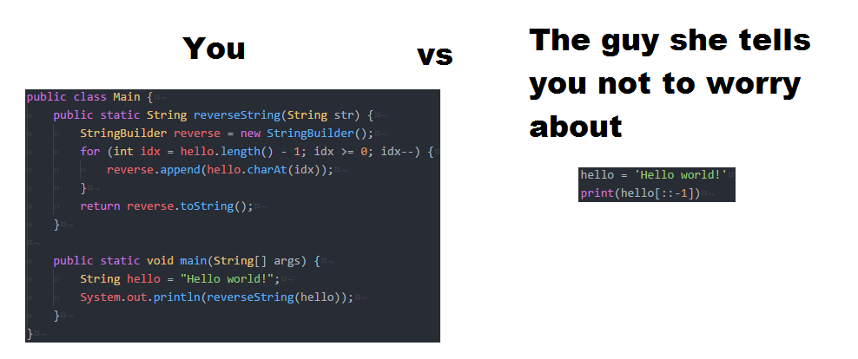

Slide 33
Sign up for Assignment 10 Get your Beagle Bone (Asg 7)

